Slide 1

Big Mountain Resort Data Modeling Report
Aaron Sullivan PhD.

Slide 2
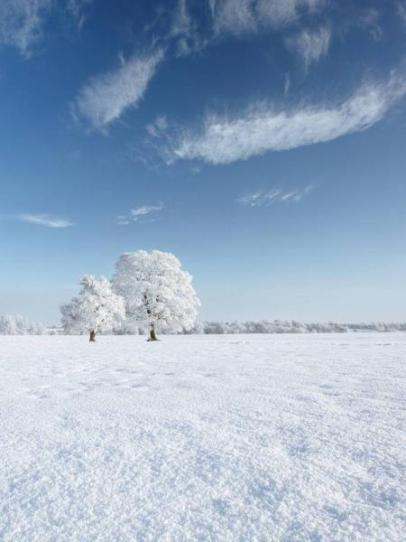
AGENDA
Problem identification
Recommendation and key findings
Modeling results and analysis
Summary and conclusion
Notes:
Problem identification (1-2 slides)
Recommendation and key findings (1 slide)
Modeling results and analysis (3-4 slides)
Summary and conclusion (1 slide)

Slide 3
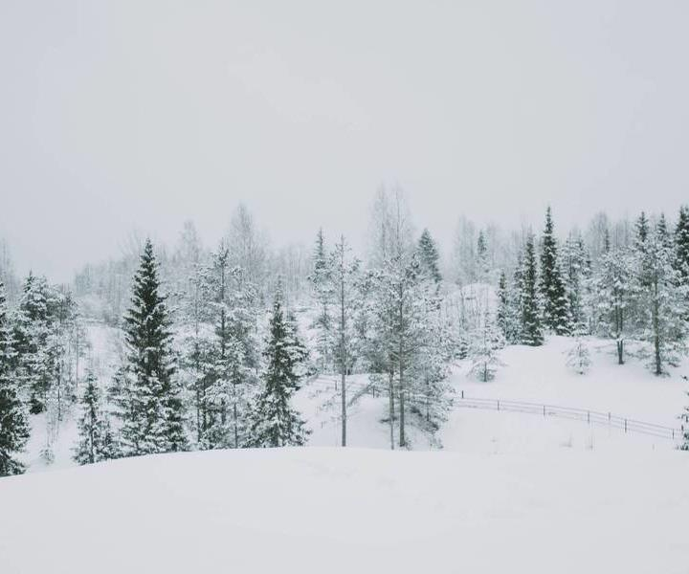
INTRODUCTION
Big Mountain resort recently purchased a new chairlift. The reported costs are to be $1.54M each season. To offset the costs for the new chair and increase overall revenue by at least 2% we have developed a data driven model from 330 US ski resorts to identify resort features which can be improved to support increase in adult weekend ticket prices.
Notes:
Problem identification (1-2 slides)
Recommendation and key findings (1 slide)
Modeling results and analysis (3-4 slides)
Summary and conclusion (1 slide)

Slide 4
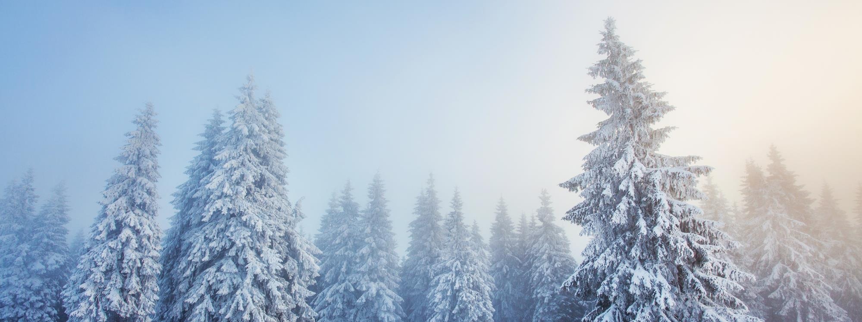
Problem identification
Which features of a ski resort best support of increasing ticket price?
Notes:
Problem identification (1-2 slides)
Recommendation and key findings (1 slide)
Modeling results and analysis (3-4 slides)
Summary and conclusion (1 slide)

Slide 5
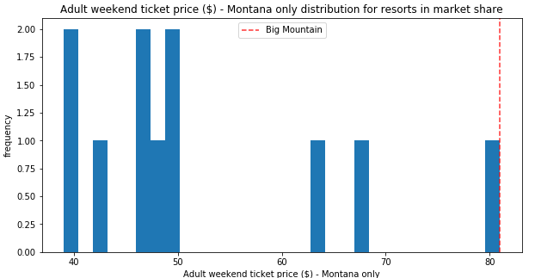
Big Mountain Resort’s current ticket price at first seems at the highest supportable level
Notes:
Problem identification (1-2 slides)
Recommendation and key findings (1 slide)
Modeling results and analysis (3-4 slides)
Summary and conclusion (1 slide)

Slide 6
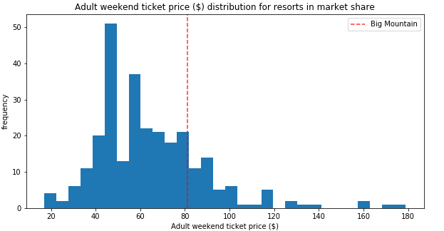
However Compared to the national average there appears to still be room for increases
But what features help support the higher prices at other resorts?

Slide 7
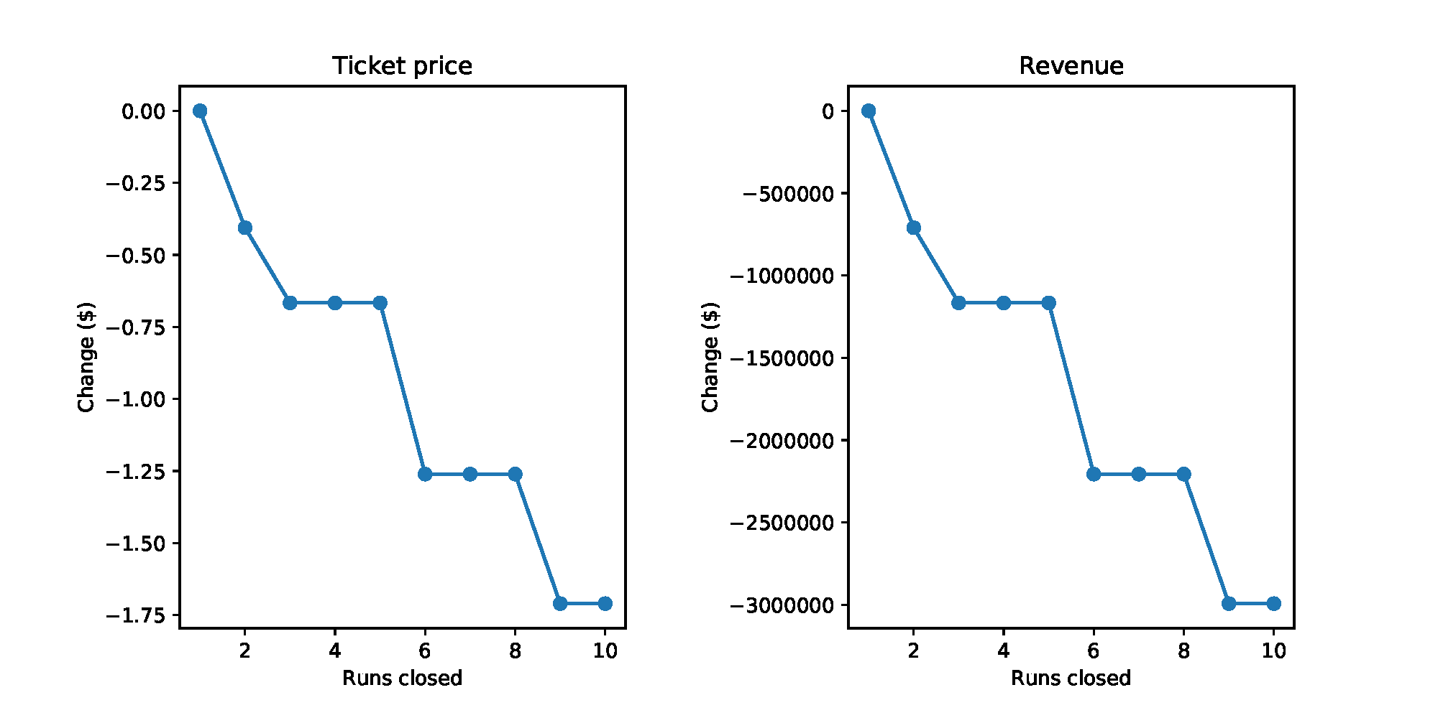
Recommendation and key findings
Scenario 1: Reduce overhead by reducing number of runs operating
Scenario 2: Increase ticket prices by adding 1 additional lift to a new run adding 150ft of vertical drop to Big Mountain Resort
This scenario increases support for ticket price by $1.99
Over the season, this could be expected to amount to $3,474,638 in additional revenue
This would amount for a 2.45% increase in ticket revenue
Assuming the cost of the chair is the same as the last new chair this should be a net gain of $1.93M
Reduction of 1 run would support current ticket price
Reduction of 3-5 runs support the same price

Slide 8
Process of Training the model
Clean data
Exploratory Analysis
Training the data
Using the model to predict outcomes
Moving forward
Of the 330 resorts only 270 had enough features to model.
24 features from the original data and 4 additional were computed from state and population data
We identified 8 features with the most influence in adult weekend pricing
We tried a number of modeling methods.
Mean price: Accuracy within $19
Linear regression: within $11.7
Random Forest: within $9.4
The model now fully trained can be used to predict the impact of adding or removing features from BMR.
Additional data could improve the model:
Children’s ticket prices,
Lesson packages
Maintenance data
Event data
Etc…
vertical_drop
Snow Making_ac
total_chairs
fastQuads
Runs
LongestRun_mi
trams
SkiableTerrain_ac
Notes:
Problem identification (1-2 slides)
Recommendation and key findings (1 slide)
Modeling results and analysis (3-4 slides)
Summary and conclusion (1 slide)

Slide 9
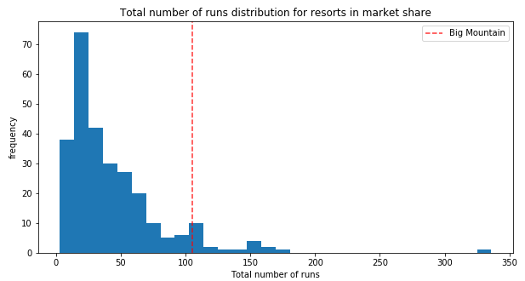
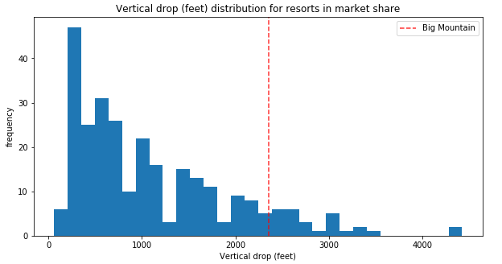
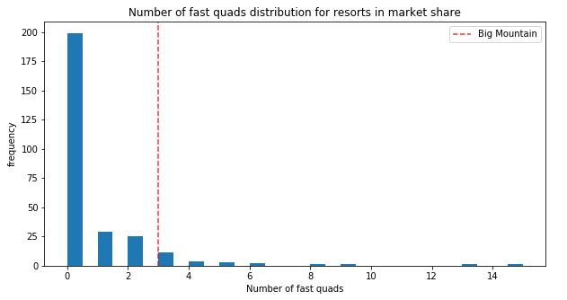
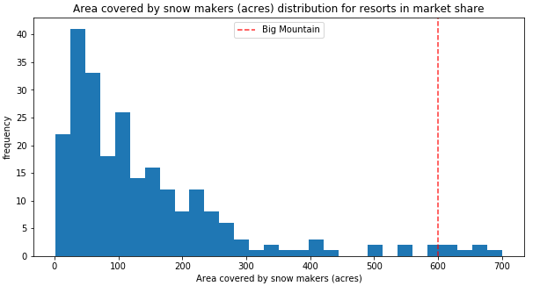
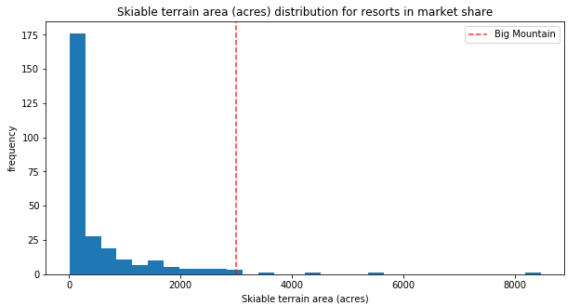
Modeling results and analysis
Our data suggests there is as much as $10 in price increase that could be supported
Total Runs
Total Lifts
Vertical Drop
Big Mountain Resort
Fast Quads
Snow Making in acres
Skiable Terrain
Notes:
Problem identification (1-2 slides)
Recommendation and key findings (1 slide)
Modeling results and analysis (3-4 slides)
Summary and conclusion (1 slide)

Slide 10
Data driven solutions
Reduction of costs modeling
Addition of features modeling
The model can calculate the loss in revenue when removing or postponing use of a terrain feature like closing runs.
The model can predict the support in increasing ticket price by adding a particular feature or a combination of features.
Examples 1: Increasing runs by 1, Vertical Drop by 150ft and total chairs by 1 This scenario increases support for ticket price by $1.99 Over the season, this could be expected to amount to $3,474,638
Example 2: Runs +1, Vertical Drop +150ft, Chairs +1, Snow Making +2 acres This scenario increases support for ticket price by $1.99 Over the season, this could be expected to amount to $3,474,638
No net gain for adding 2 acres of snow making in this projection
Notes:
Problem identification (1-2 slides)
Recommendation and key findings (1 slide)
Modeling results and analysis (3-4 slides)
Summary and conclusion (1 slide)

Slide 11
Additional data to improve predictions
Children’s ticket prices
Lesson packages
Cost of grooming runs
Cost of maintaining chairlifts
Special events (cost & increase in ticket purchases)
Breakdown of difficulty level per run
Food purchase revenue
Mid mountain café/eatery
Equipment sales
Equipment rental
Out of state traffic
Etc…
There are a number of data points that were not available in the current model Obtaining this data can help improve the model and make for more accurate predictions

Slide 12


SUMMARY
The current data model can help predict the support for ticket sales increases based on the 32 resort features in the model.
The model predicts that revenue would be increased by 2.45% or $3,474,638 by adding one new chair which gave access to a new run which increases vertical drop of the resort by 150ft and supports a $1.99 increased adult weekend ticket price.
With our model we can better prioritize feature additions to the resort as well as how the market will support changes to ticket price based on these changes.
Notes:
Problem identification (1-2 slides)
Recommendation and key findings (1 slide)
Modeling results and analysis (3-4 slides)
Summary and conclusion (1 slide)

Slide 13
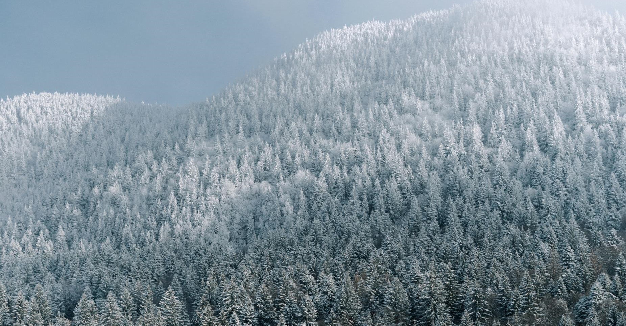
THANK YOU
Aaron Sullivan PhD.
Data Scientist
Big Mountain Resort
2021
Big Mountain Resort Data Modeling Report
Notes:
Problem identification (1-2 slides)
Recommendation and key findings (1 slide)
Modeling results and analysis (3-4 slides)
Summary and conclusion (1 slide)

Slide 14
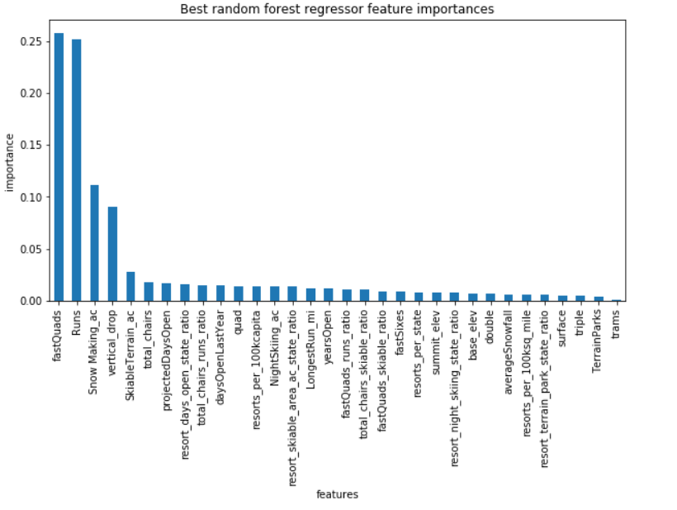
Of 330 resorts in the US we identified 8 features which had a significant impact on the Adult Weekend price of other resorts
These features were;
# of fast quad chairlifts
# of ski runs
Snow Making by acre
Vertical Drop (from top of run to bottom)
Skiable terrain by acre
Total number of chairs
Longest run (in miles)
Trams (data was sparse)

